Slide 1
Spooky Nook Meetings and Events Manheim, PA
SNAPa Board Presentation
July 28, 2019

Slide 2
Hershey Lodge vs. Spooky Nook
Hershey Lodge
Spooky Nook
Established Property
665 Rooms, share property with public and other conferences
Wifi
No outside food allowed
Pipe/Drape
Newer Venue
135 Hotel Rooms—run of house
Wifi included; $40/day upgrade needed
Donated food for breaks OK
Pipe/Drape—purchase own; use General Expo
Can use outside AV w/no fee

Slide 3
The Numbers
$229 Room Rate
$21,000 Meeting Room Rental
$35,500 F/B Minimum
$25,058 A/V Cost Estimate
100,000 Sq Ft Meeting Space
35 Meeting Rooms
Indoor Water Play Area—included
$159 Room Rate
$4,500 Meeting Room Rental
$20,000 F/B Minimum
$23,940 A/V Cost Estimate
53,000 Sq Ft Meeting Space
7 Meeting Rooms+ 5 sm rooms
100,000 St Ft Fitness Center with Ninja Warrior Course—included

Slide 4
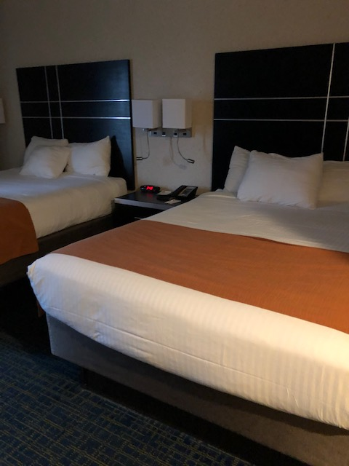
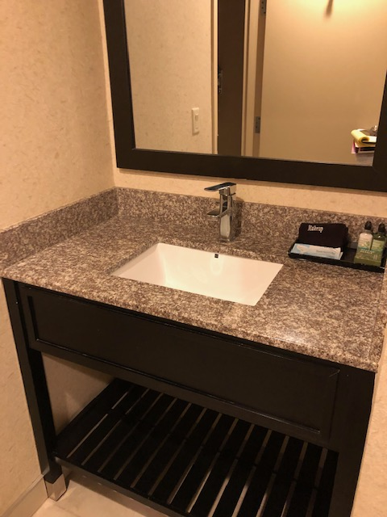
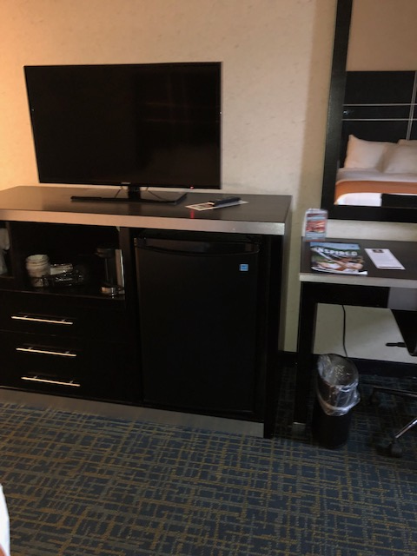
The Warehouse at The Nook Guest Rooms

Slide 5
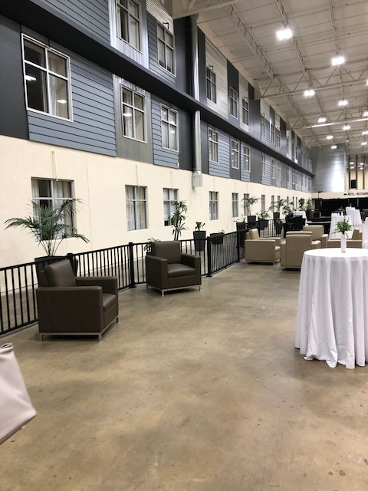
Event Space at The Nook
EVENT SPACE
AT THE NOOK

Slide 6
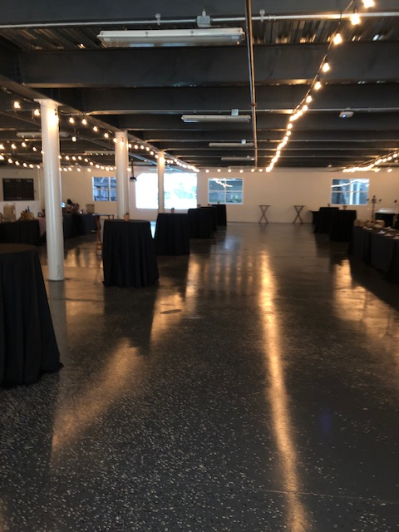

Slide 7
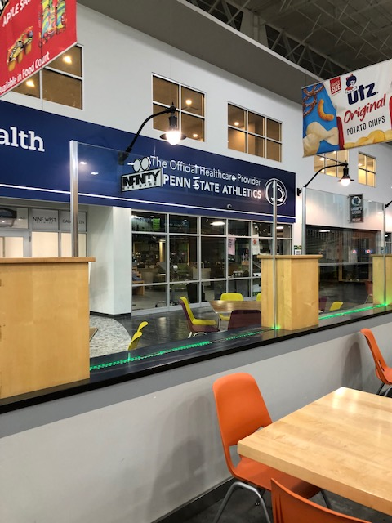
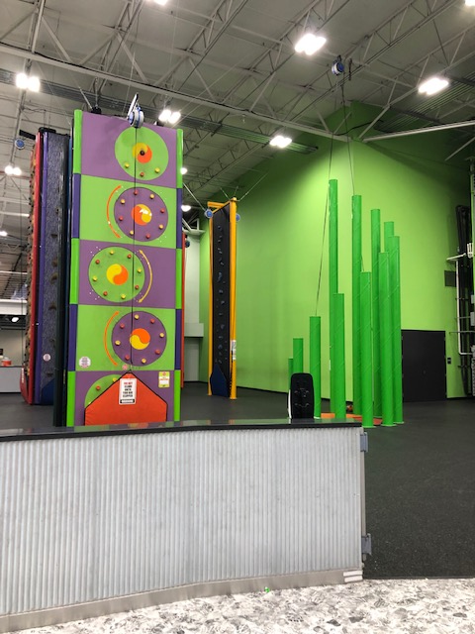

Slide 8
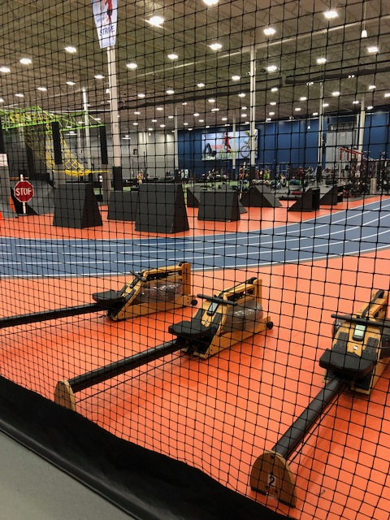
Ninja Warrior Course
Courts & Turfs
Complete Fitness Center
Group Exercise Classes Daily
Customizable Teambuilding Events

Slide 9
See for yourself
Spooky Nook Video

